Slide 1
Forensic Management System
Cravita Technologies.
A Project By :
Akshay Bhambure. Vishakha Penmahale.
Rasik Nille. Shital Kharade.
Mukund Gaikwad. Nikita Kukreja.
Rushikesh Pawar. Sonam Karale.
Komal Bhapkar.

Slide 2
Content:
Introduction
Diagrams
Database
Input Screen
Report
Conclusion

Slide 3
Introduction
Modern science and technology has revolutionized the field of crime solving and has made the process much faster and more reliable. The word Forensic refers to all the science and technology used in the solving of crime. The aim of this system is to manage the large volumes of data that are produced in the process of solving crimes by the application of scientific methods and modern technology.

Slide 4
Existing system and need for system
In Police Departments today, paper case files are created for each case. These files are usually kept at the Police station and only one copy is maintained. Access to the file depends on how vigilant the station officers are. Generally inspectors and detectives rely on their memory of peculiar case details to form connections between cases. Different reports are requested from laboratories or other departments and each of these facilities have to courier these sensitive documents, which takes time.

Slide 5
Proposed System
The proposed system will be able to reduce the paper trail required in the process. Digital files will make the sharing and appending of case files extremely easy. Since access to the system is required to view a case file it becomes very simple to track and regulate access to the case files. Documents from different laboratories regarding analyses can be securely and instantly sent via the internet. This system will augment the crime solving and record keeping abilities of a modern police force.

Slide 6
Scope of Work
The objective of the system is to provide the facility to police and forensic department.
Admin can do different requests by login one time only.
It has different users like Admin, Officer, Supervisor and Guest.
Officer as well as Guest can also check the status of his requests.
When Guest login in this system it will fetch all information of case.
Admin is service provider to provide the service on the request.
Admin can allocate the role from his desk for different Supervisor, Officer and Guest.

Slide 7
What is Forensic Management System ?
When creating a new case file the system will be able to store specific information in categories. Such as crime scene photographs, details about any firearms used, all fingerprint and DNA reports, etc. Fingerprint reports and DNA reports can be sent to the concerned laboratory from this system and the results can be viewed on the same. All detective notes will also have to be entered on this system.
In the event that a detective has to cooperate with other departments, this system can be used to easily collaborate on case files, temporary user profiles can be created if the other department does not implement this system.

Slide 8
Module Specification
Admin: The admin can create user profiles and will be able to track user activity. Any attempts to breach the security of the system will automatically lock out the system and notify the admin.
Supervisor: The supervisor module is reserved for the higher officials in the police department. They will be able to view current and past case files and statistics about solving crimes.
Officer: The officer module will be able to create case files and can add information in the same. They will be able to search old case files and order reports from different facilities.
Guest: The guest profile can be created for officers from other departments who are collaborating on the investigation. They will be able to add data about the case they are investigating but will not be able to access historical case files. Any request for access to old case files will be routed to the profile of Officers they are working with and will have to be approved by them.

Slide 9
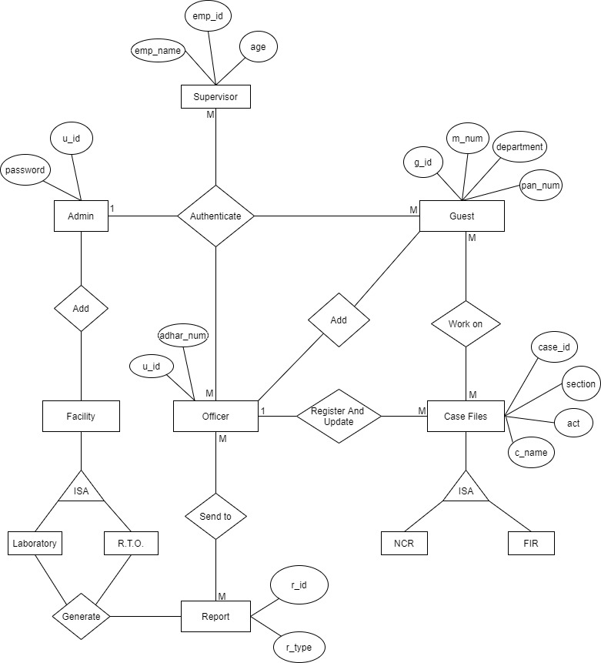
Diagrams: 1.ERD

Slide 10
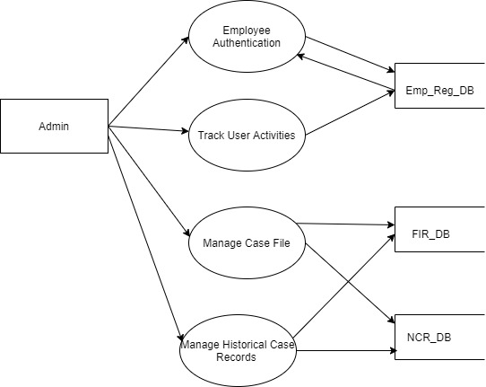
2.DFD for Admin

Slide 11
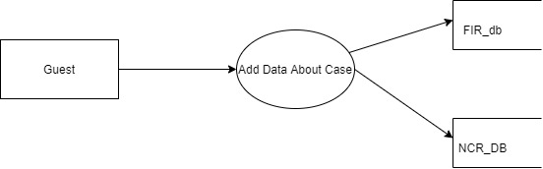
2.DFD for Guest

Slide 12
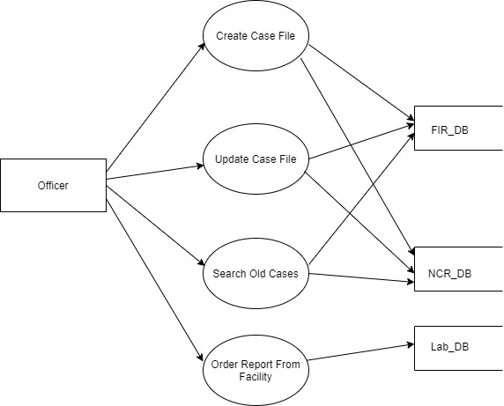
2.DFD for Officer

Slide 13
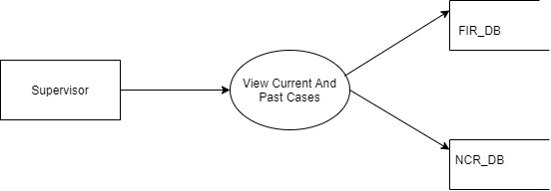
2.DFD for Supervisor

Slide 14
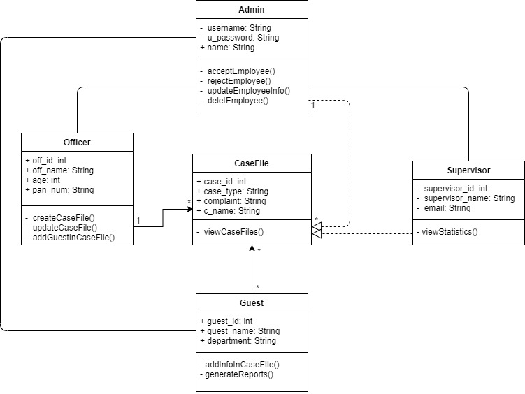
3.Class Diagram

Slide 15
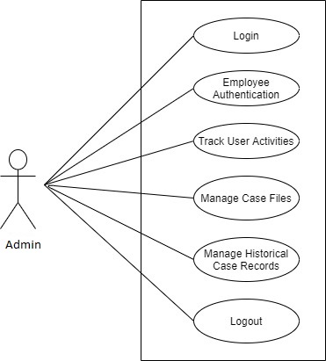
4.Use case Diagram

Slide 16
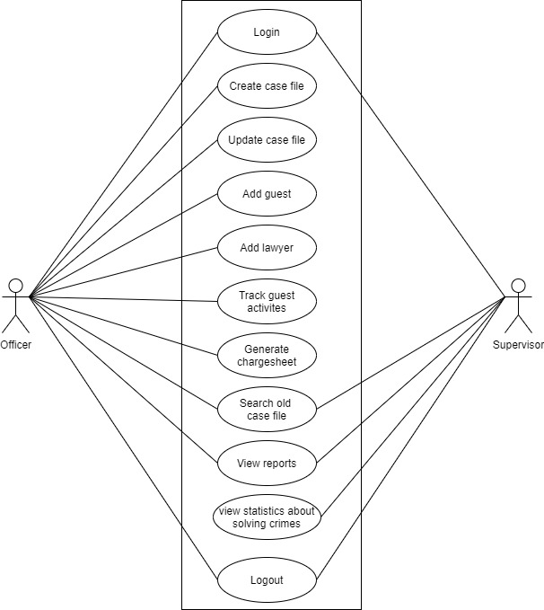
4.Use case Diagram

Slide 17
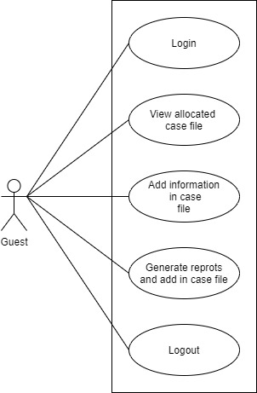
4.Use case Diagram

Slide 18
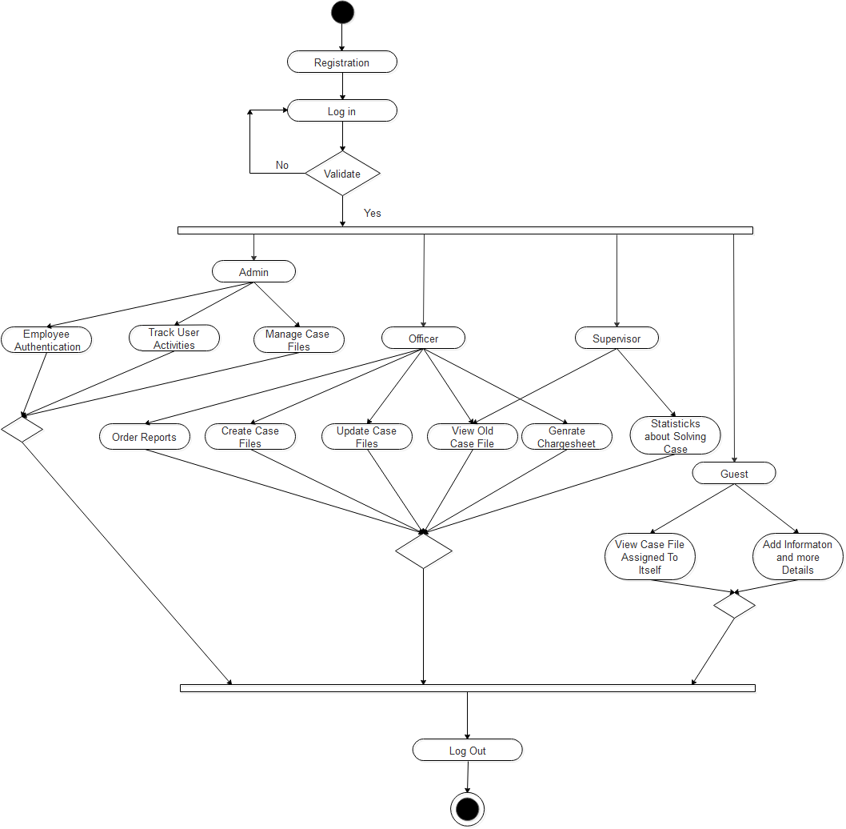
5.Activity Diagram

Slide 19
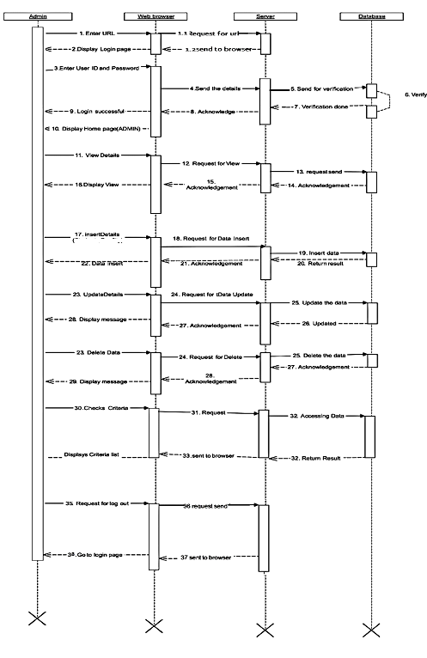
6.Sequence Diagram

Slide 20
Future Enhancement
Android Application.
Cyber Security Department.
Court Department.

Slide 21
Conclusion
The design and development of the system will significantly enhance the simplicity of the system. This system is economical, technical as well as operational feasible. No maintenance cost will occur in this system.
During the development of this system, we had learn cutting edge technologies like JAVA, Bootstrap, JavaScript and Specially involving REST APIs, which will definitely help us in our future and will help us in growing our career.
Although during the project development, we came across many problems both technical and conceptual. But we were able to solve most of them while developing the system. Also, we can’t ignore the drawbacks and limitations of our system and in future we will make the enhancement on the system. Any project, even on completion still is not done. Constant improvement, upgrades and changes need to be made and newer versions are released.
The computerization system will help to keep records of all cases, all information, overall evidence , Reports Also all officers, all supervisors, all guests with more accuracy, which will avoid unnecessary delays in this innovative system.

Slide 22
Database
Admin
Name | Data Type | Siz | Constraints | Description
Id | int | 5 | FK | Id of Admin
Email | Varchar | 50 | - | Email of Admin
Password | Varchar | 50 | - | Password of Admin
Case type
Name | Data Type | Size | Constraints | Description
cid | int | 5 | PK | Id of case
off_id | Varchar | 5 | FK | Id of Officer
Casetype | Varchar | 50 | - | Type of case

Slide 23
NCR File
Name | Data Type | Size | Constraints | Description
ncr_no | Varchar | 5 | PK | Id of Ncr case
Act | Varchar | 20 | - | Acts of case
Section | Varchar | 25 | - | Section of case
R.A.P.S date | Varchar | 10 | - | Date of complaint registration
Time | Numeric | 5,0 | - | Time of complain registration
Nameofcomplainant | Varchar | 50 | - | Name of complainant
nameofwitness | Varchar | 50 | - | Name of witness
Briefofcomplaint | Varchar | 150 | - | Brief of complaint

Slide 24
Employee
Name | Data Type | Size | Constraints | Description
Emp_id | Varchar | 5 | PK | Id of Officer
FirstName | Varchar | 50 | - | FirstName of Officer
MiddleName | Varchar | 50 | - | MiddleName Of Officer
LastName | Varchar | 50 | - | LastName of Officer
Age | Varchar | 50 | - | Age of Officer
Specialization | Varchar | 50 | - | Specialization of Officer
Designation | Varchar | 50 | - | Designation of Officer
Department | Varchar | 50 | - | Department of Officer
Gender | Varchar | 50 | - | Gender of Officer
DOB | Date | 50 | - | DOB of Officer
ContactNumber | Varchar | 50 | - | ContactNumber Of Officer
EmailId | Varchar | 50 | - | EmaiId of Officer
Password | Varchar | 50 | - | Password of Officer
OAdhar_number | Varchar | 50 | MUL(Unique) | Adhar_number of Officer

Slide 25
FIR File
Name | Data Type | Size | Constraints | Description
Fir_no | Varchar | 5 | PK | FIR no
S_id | Varchar | 5 | FK | Id of supervisor
G_id | Varchar | 5 | FK | Id of Guest
State | Varchar | 20 | - | State of crime
District | Varchar | 10 | - | District of crime
Act | Varchar | 10 | - | Act of crime
Section | varchar | 10 | - | Section of crime
Year | Numeric | 5,0 | - | Current year
Date | Date | 10 | - | Current date
Entry_no | Numeric | 10 | UNI | Entry no of case in file
Occurance_date | Date | 10 | - | Date of occurances
Date_of_casefileatPS | Date | 10 | - | Date of case registered in PS
Choukino | Numeric | 10 | UNI | Chouki no of police station

Slide 26
Information in case by guest
Name | Data Type | Size | Constraints | Description
Case_id | Int | 5 | FK | Id of case
image | Varchar | 5 | FK | Evidence
Info | Varchar | 50 | - | Description of evidence
Guest_id | 12 | 5 | FK | Id of guest who add this information

Slide 27
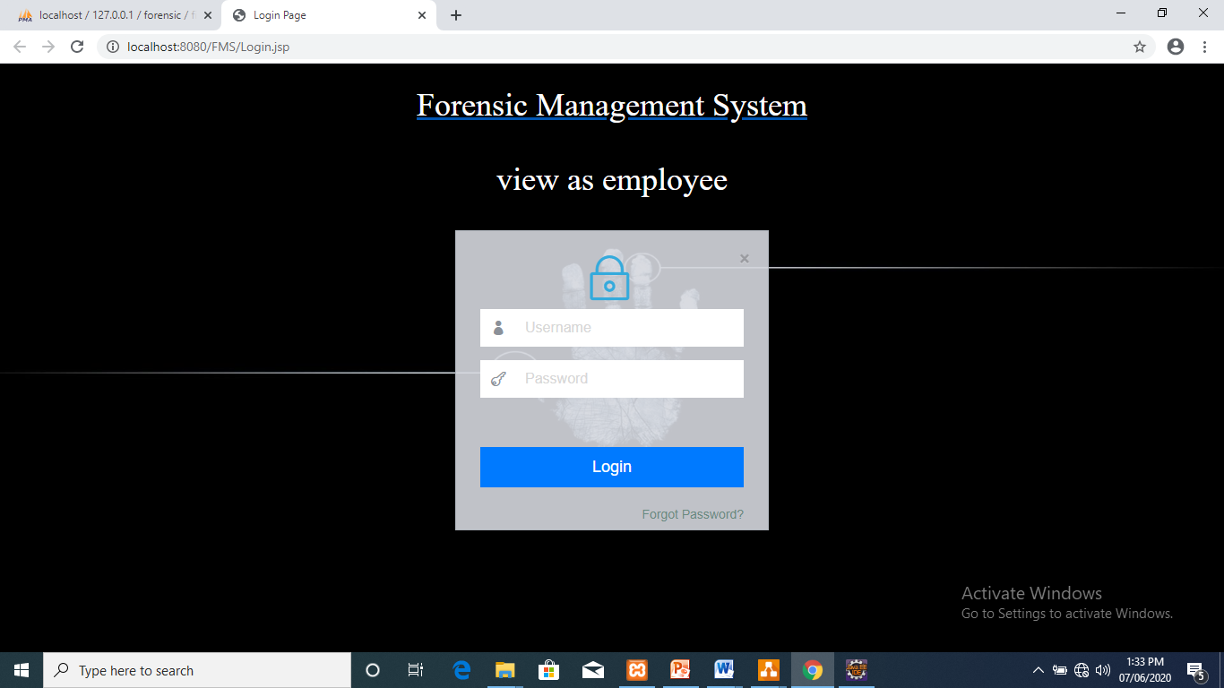
Input Screens
Login for Admin and employee

Slide 28
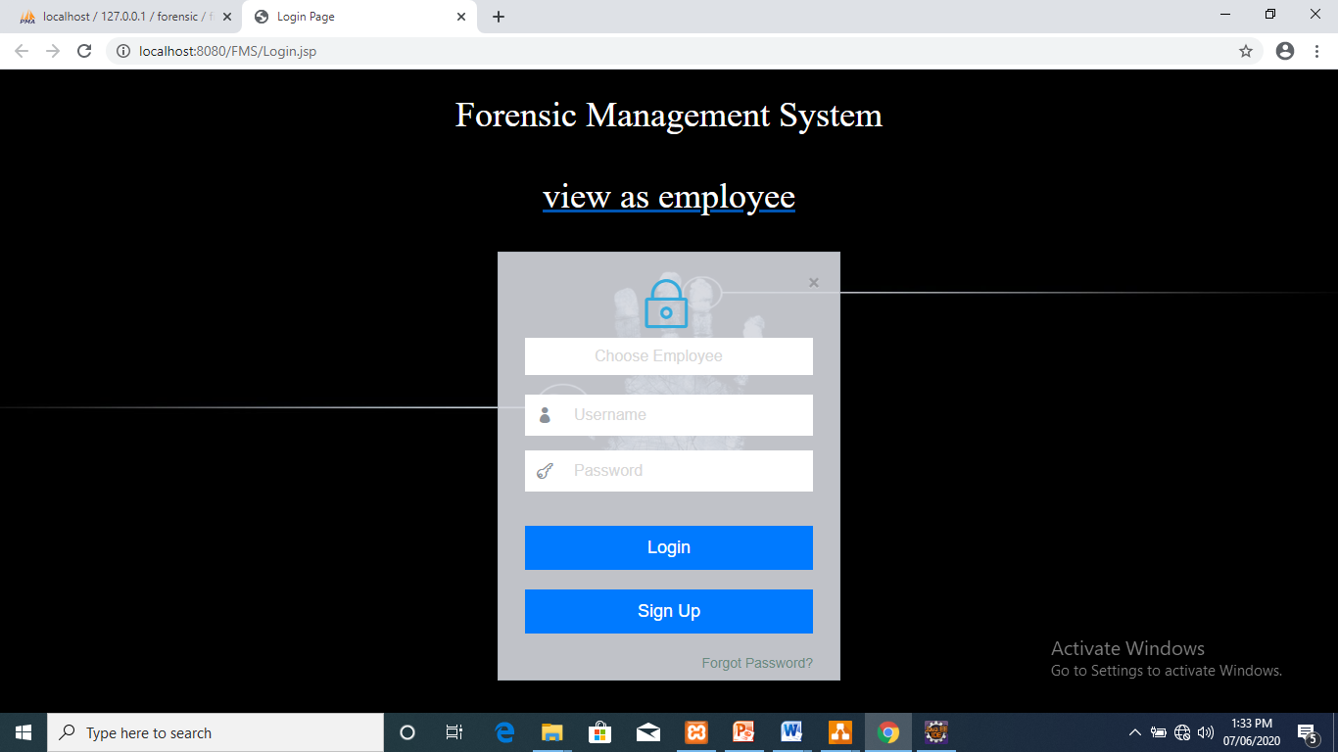
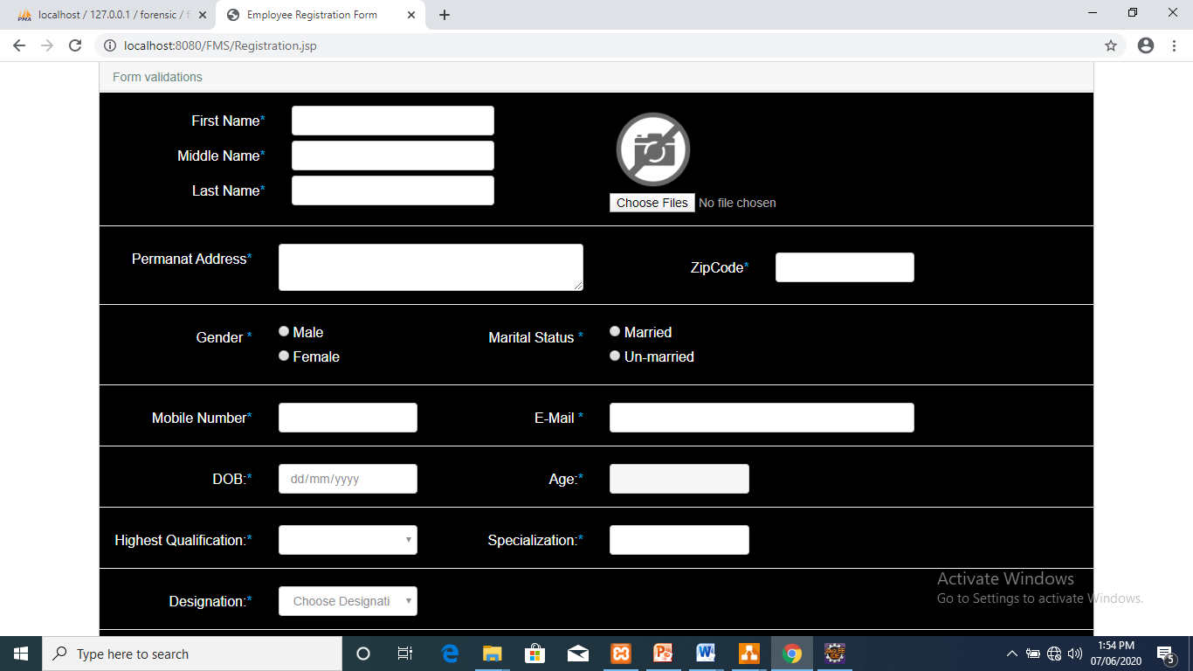
Employee registration form

Slide 29
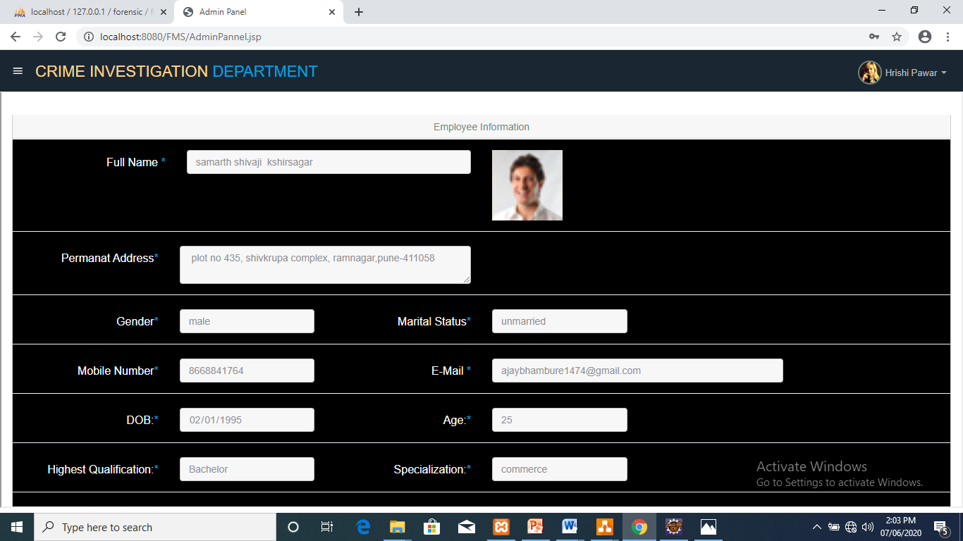
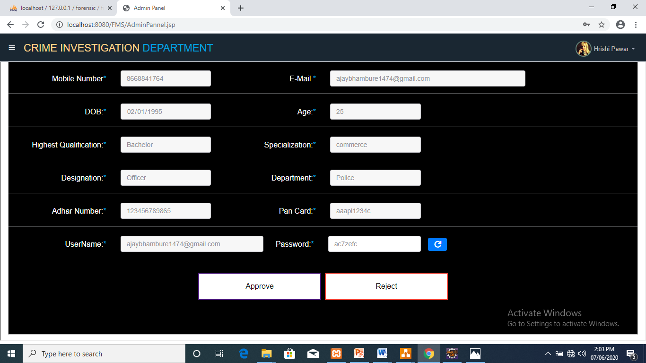
Employee Authentication by Admin
Username and password provided by admin

Slide 30
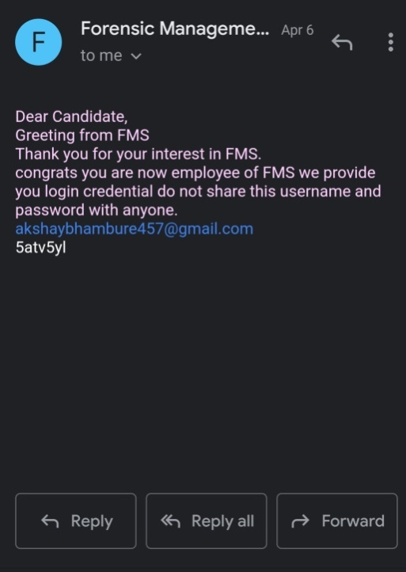
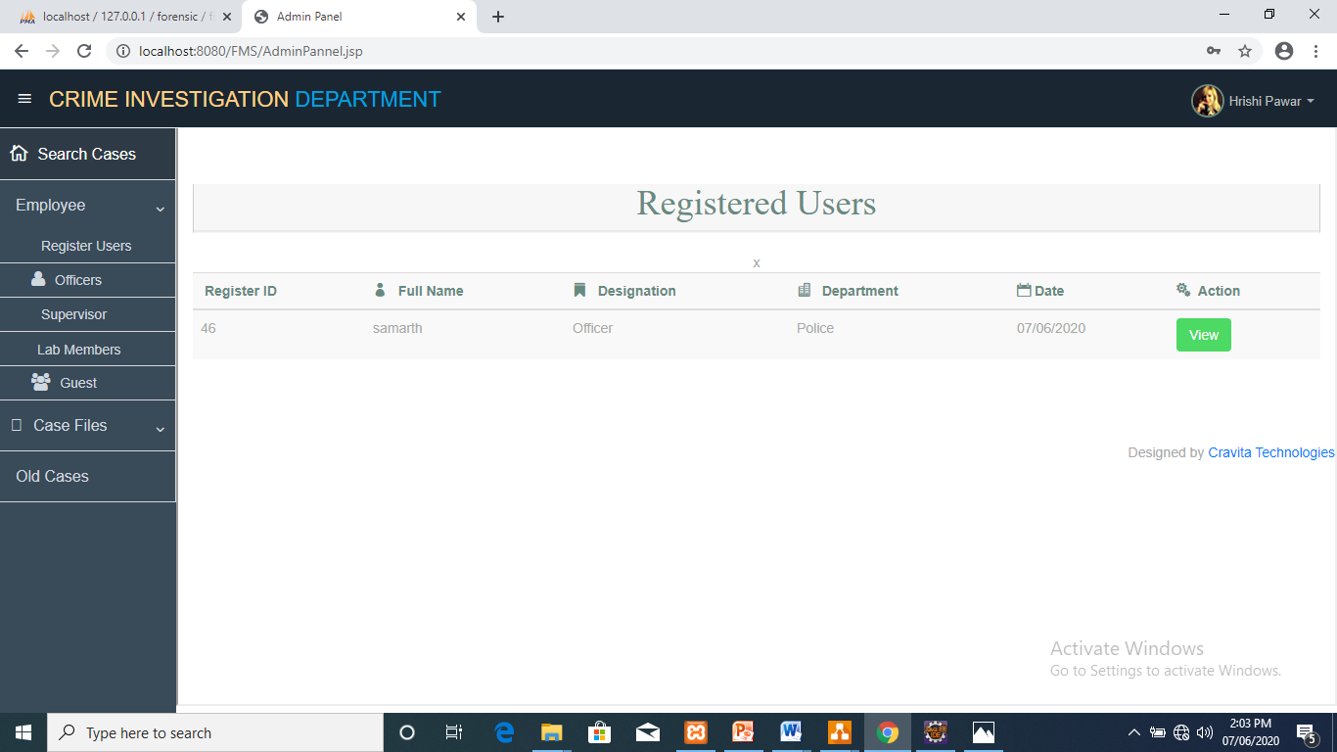
Admin Panel - Registered Employee

Slide 31
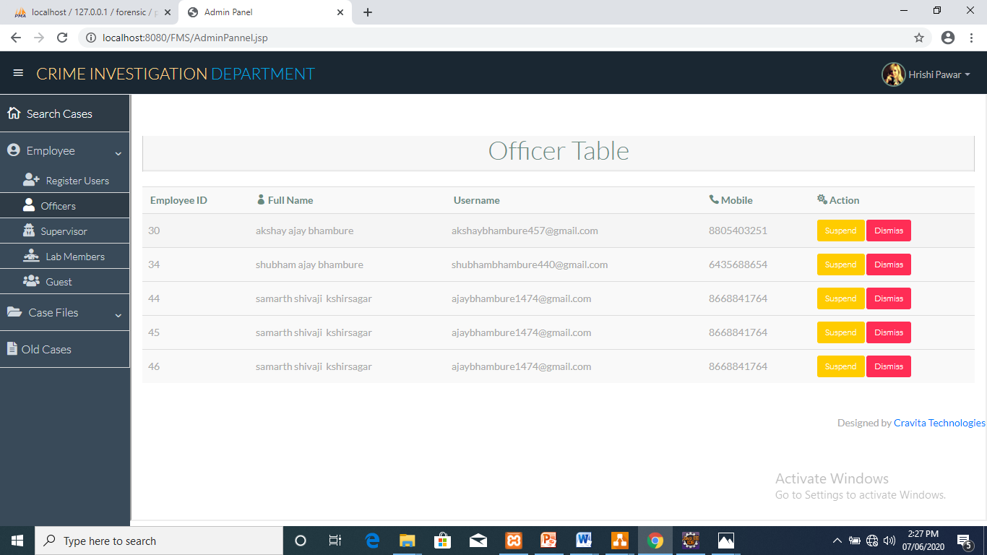
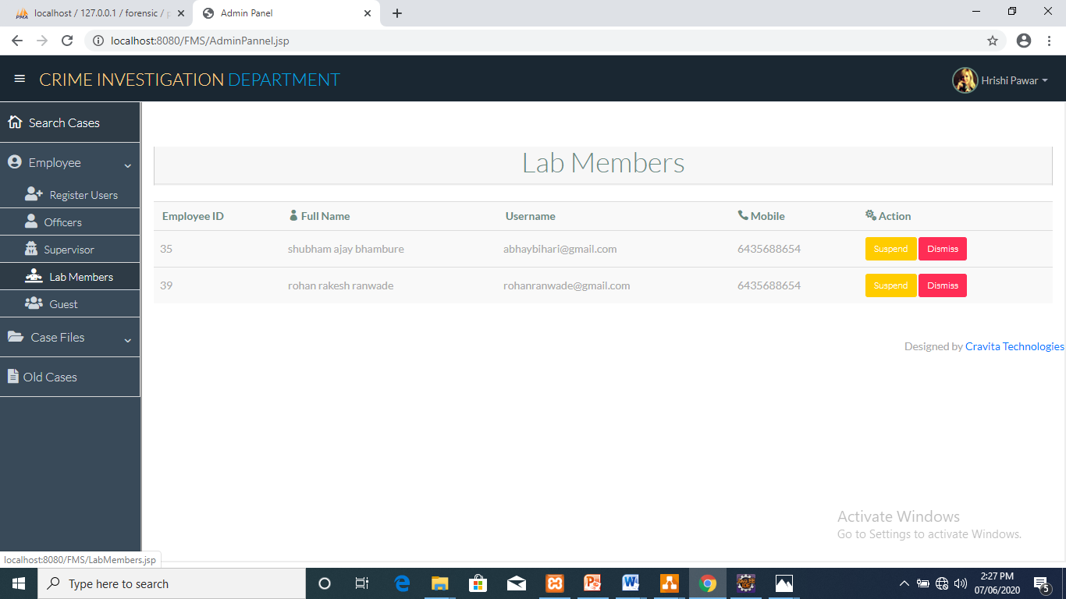
Officer Table
Guest Table

Slide 32
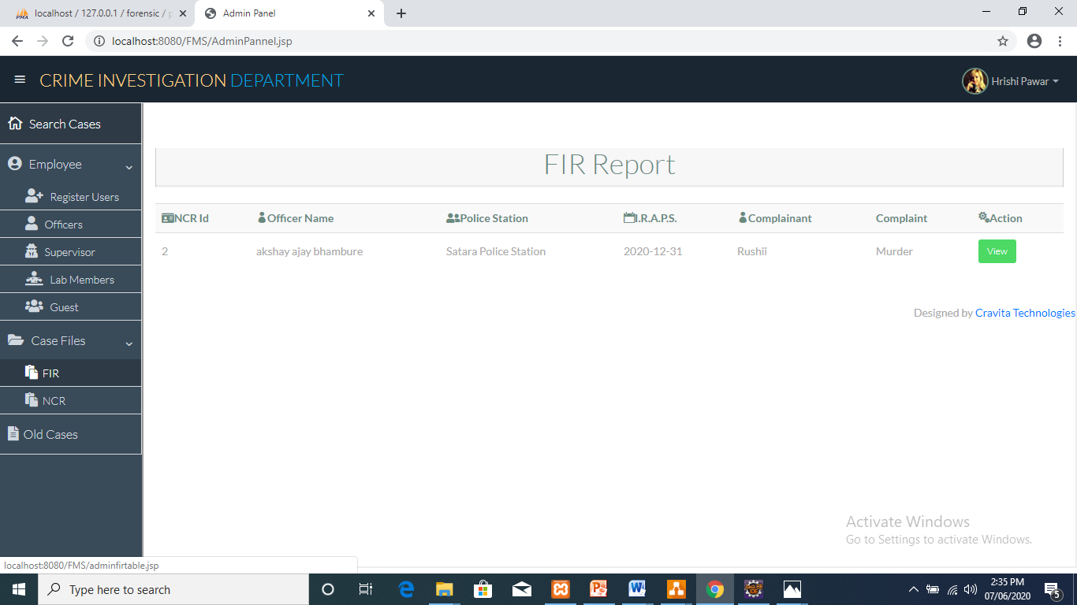
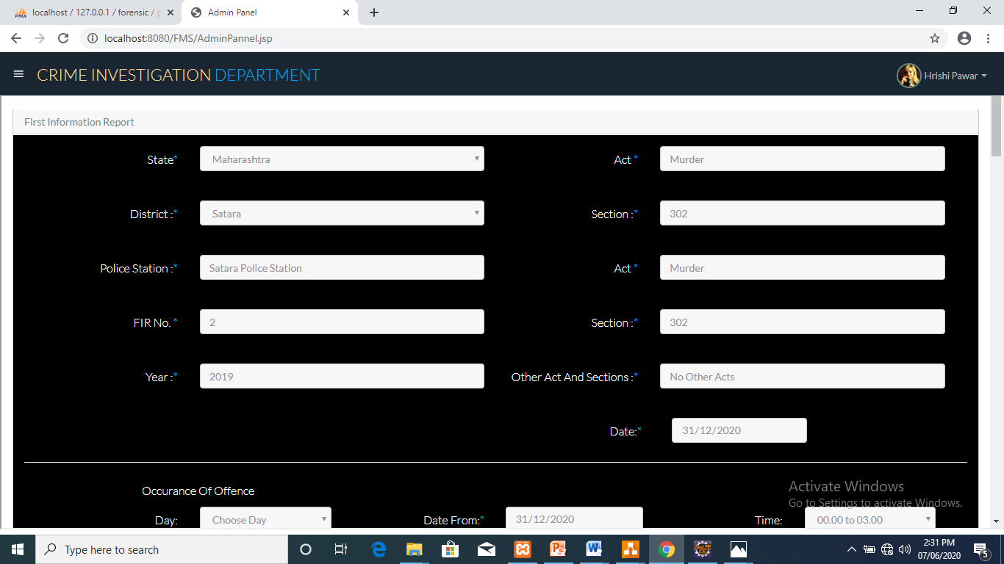
Case Files for Admin – FIR

Slide 33
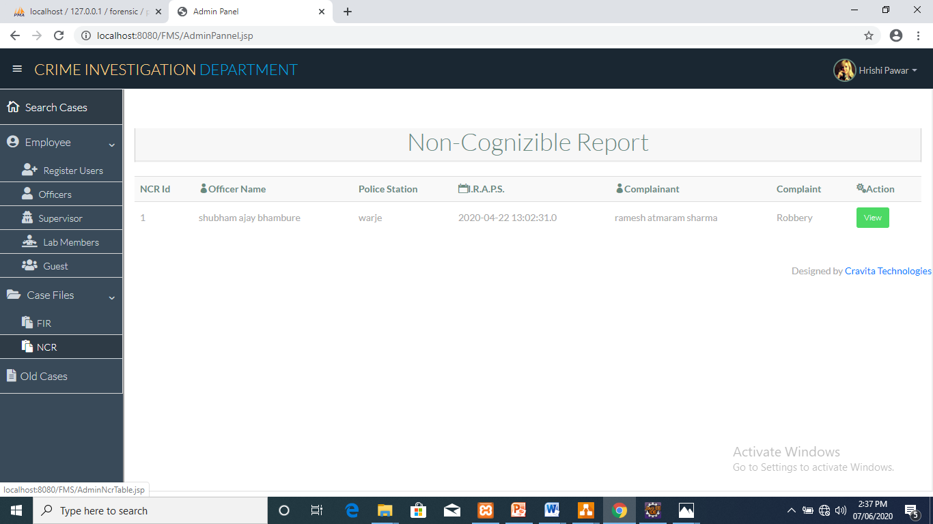
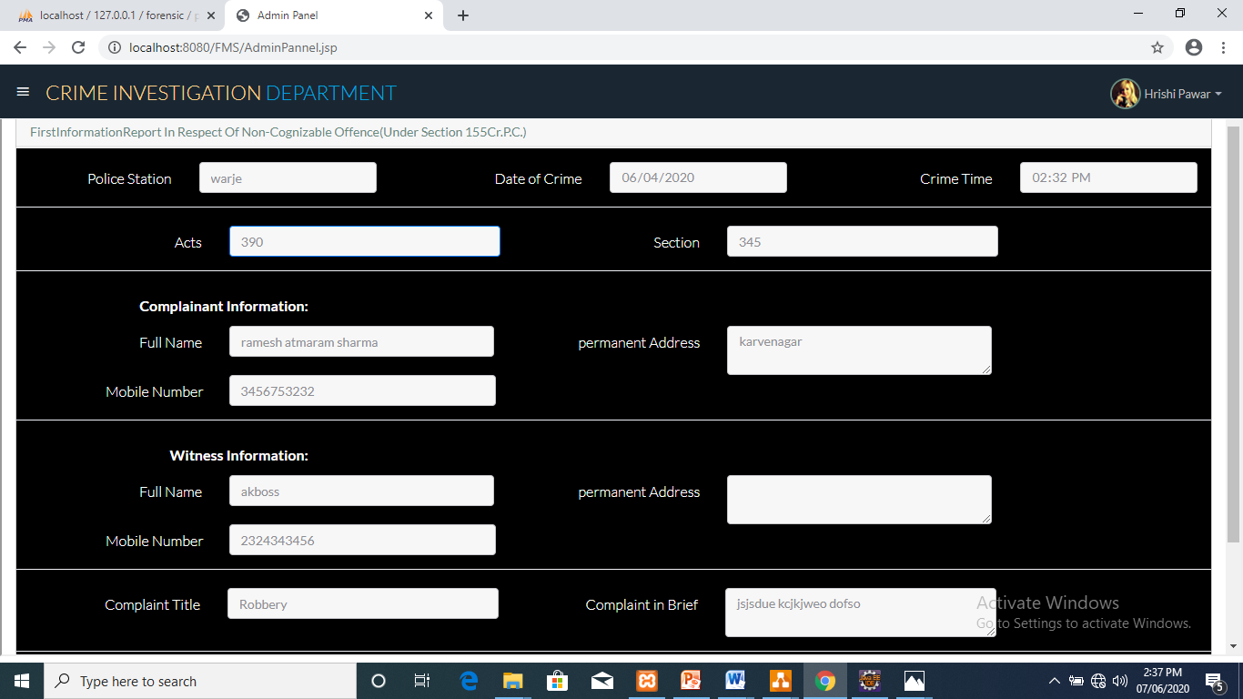
Case Files for Admin – NCR

Slide 34
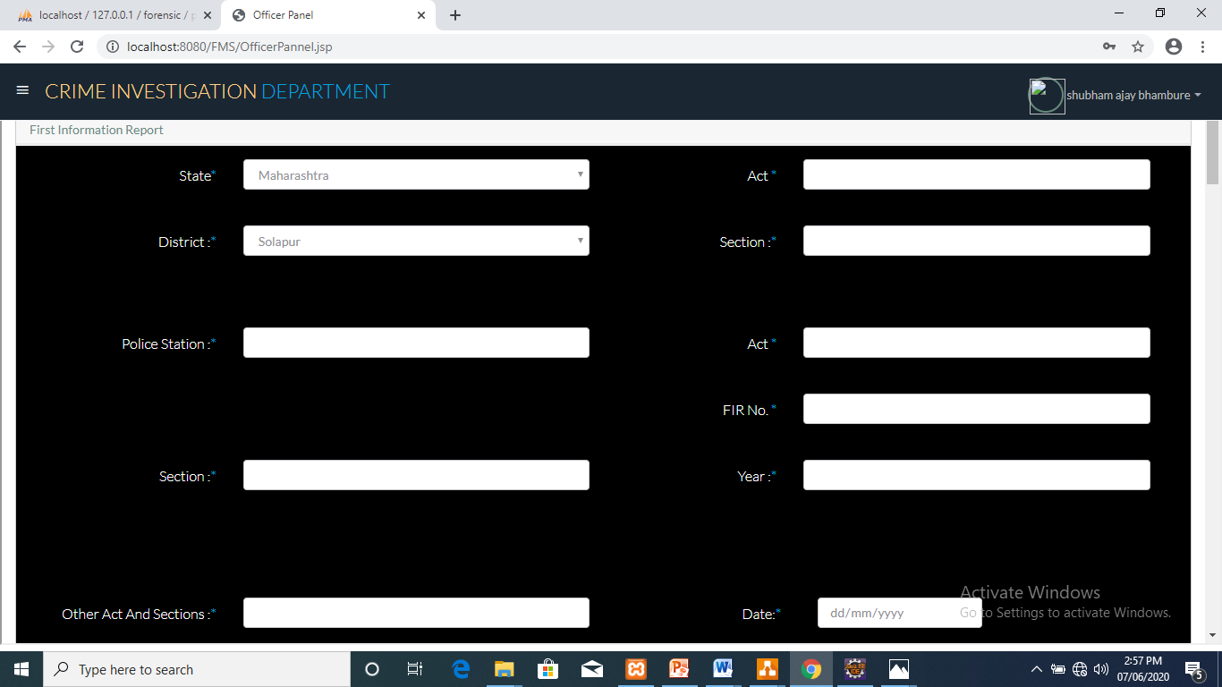
FIR Form

Slide 35
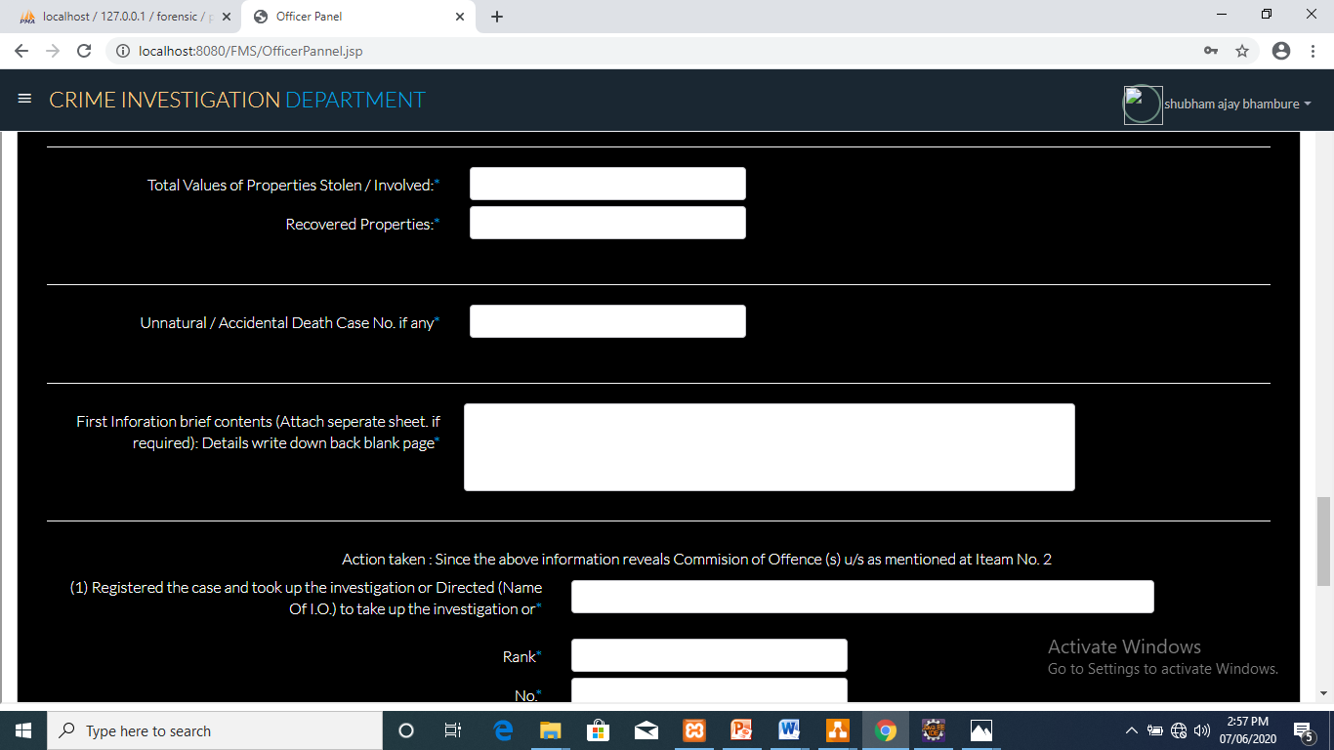
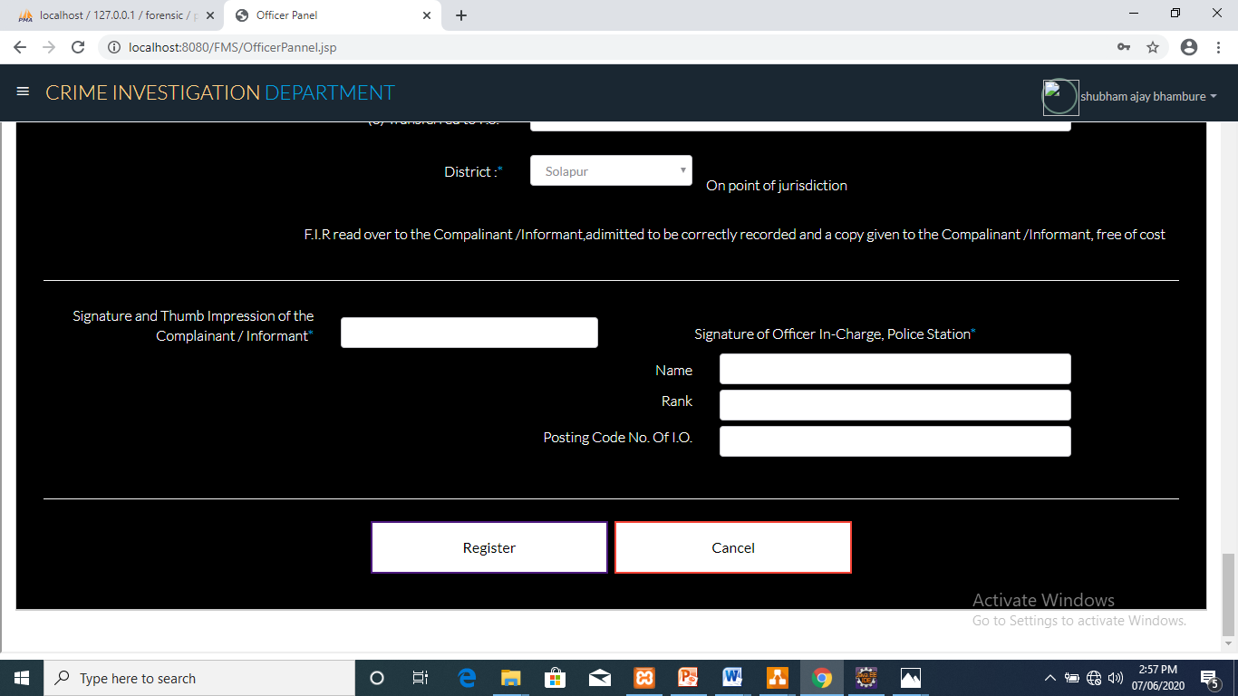

Slide 36
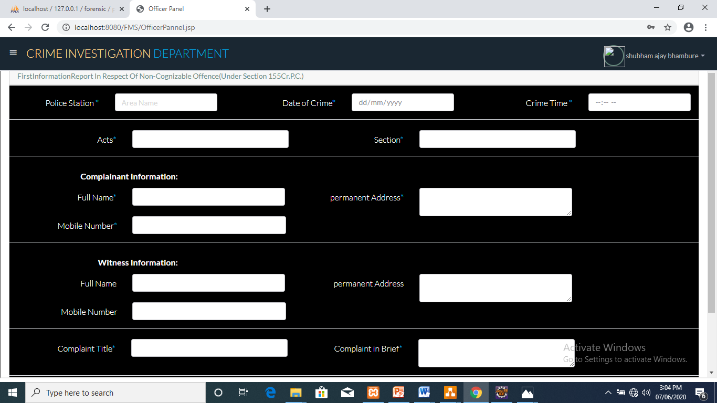
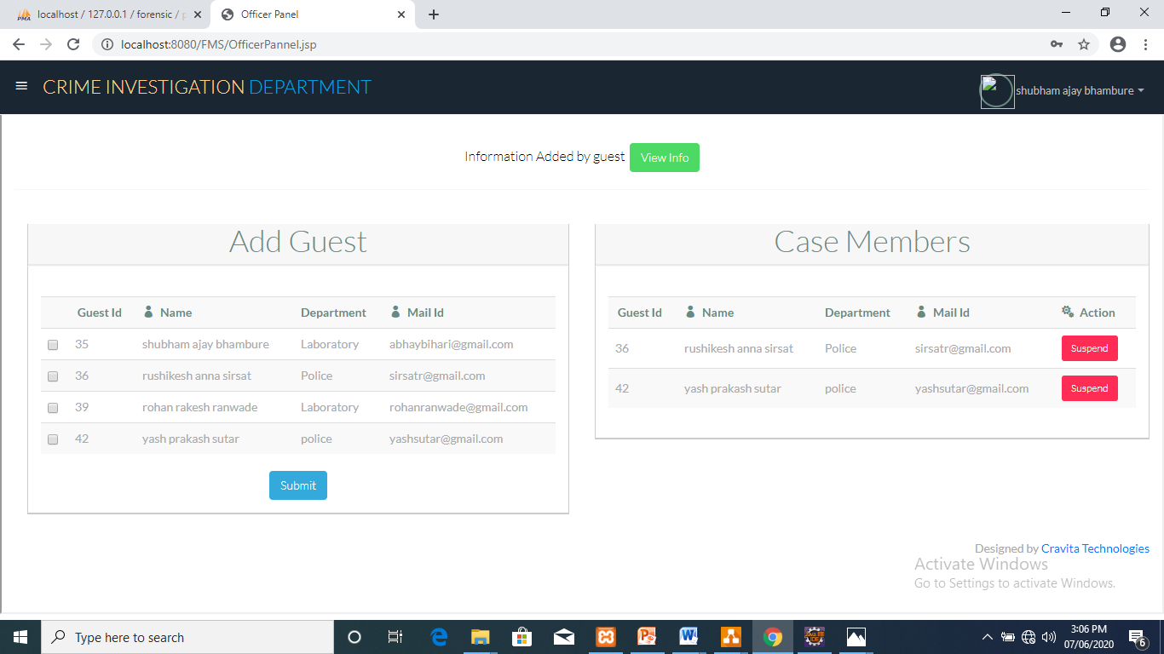
NCR Form
Add guest in case file

Slide 37
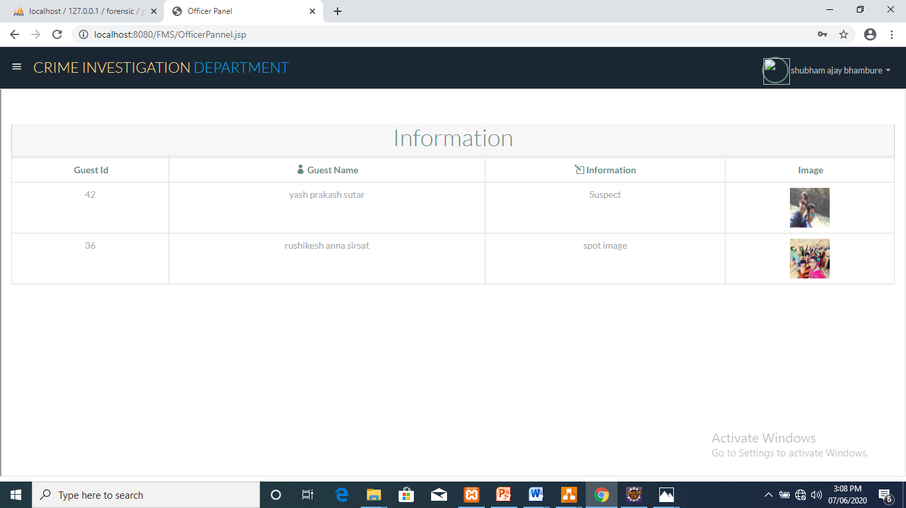

View Information added by guest
Search old case files

Slide 38

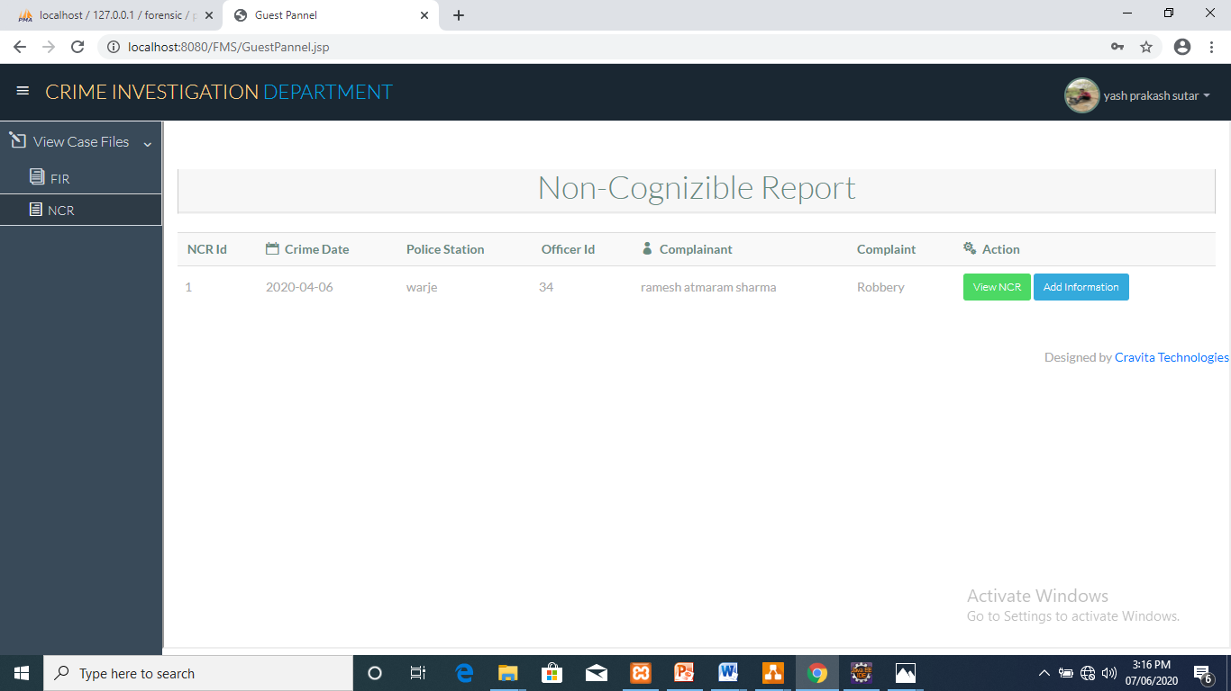
Search result
Case table for guest

Slide 39
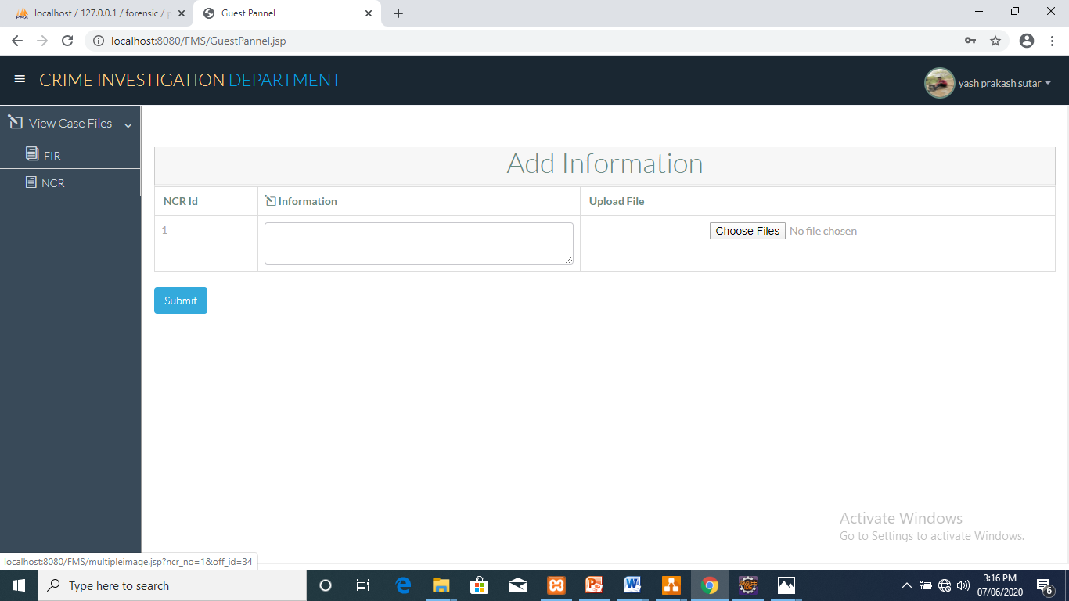
Add information in case file by guest

Slide 40
THANK YOU !!!

